Slide 1

Risk Factors for Maltreatment
CAST 301 Chapter 2 Dr. Edwards

Slide 2
Agenda
Quiz
Attendance
Announcements
Chapter 2 lecture

Slide 3
Family Factors
Parental factors
  What would make a parent more likely to become abusive?
  Gender differences
  Substance abuse – a couple of different ways….
    2/3 of fatalities
  M.I.
  Preparation
    How do you prepare for a child?
  Intergenerational transmission???

Slide 4
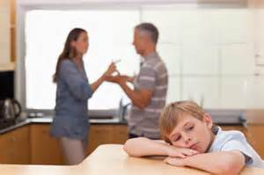
Family Factors continued…
Family Structure & Functioning
  What does this mean?
  Single vs. Married
  D.V.
  Family size
  Poor functioning
    Examples?

Slide 5
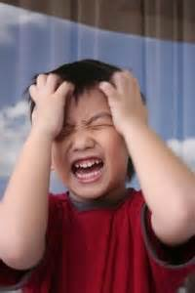
Child Factors
When is it the child’s fault?
  Gender & Age
  Temperament
  M.I.
  Disabilities

Slide 6
Extrafamilial Factors
Support systems in place
  Socially isolated
Community impacts?
  Examples?
Poverty
  Why? How?
Military Families
  More or Less? Why?

Slide 7
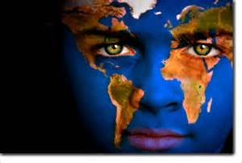
Cultural Factors
Do we live in a ‘culture of violence?’
  Why or why not?
  How does this play into maltreatment?
  Corporal punishment
    The only people you can legally hit in the U.S.
  Others?

Slide 8
Small groups
Case study on page 40
  2 discussion questions
Discussion questions on page 40 and 41
  1, 2, 3, & 5

